Slide 1
Portal Room Billing
By: DaiShawn Richards, Lock out Todd

Slide 3
Adding A Charge
Click Summer Camps
Then billing under System Maintenance

Slide 4
Click Summer Camps
Then billing under System Maintenance
First select which camp you would like to bill
Then click on “Billing”

Slide 5
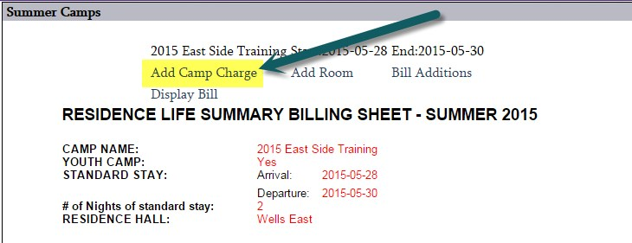
Next click on “Add Camp Charge”

Slide 6
Billing will default to Custom charge if you need to change it click the bubble under “camp” for a miscellaneous charge.
You may charge the Camp, Hall, Floor, Room, or Individual.
If you do a custom charge make sure to change bill section form “contracted services” to “Miscellaneous Charge” in the dropdown.
Finally Click “Add Charge”

Slide 7
Deleting a Charge
Click Summer Camps
Then click Delete Camp Charges under Extended Tools tab

Slide 8
First Select the camp you wish to remove a charge from

Slide 9
Next select which charge from the camp you wish to delete.
Click “Review Charges to Delete”

Slide 10
Finally make sure you have selected the correct charge you wish to remove
Click “Confirm Delete

